Slide 1
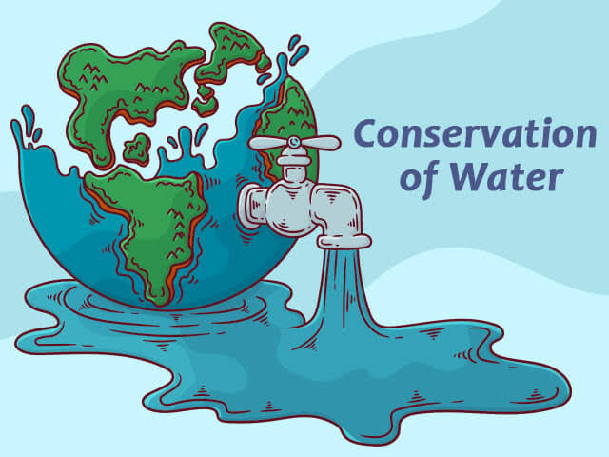
WATER CONSERVATION
“Thousands have lived without love, not one without water.”

Slide 2
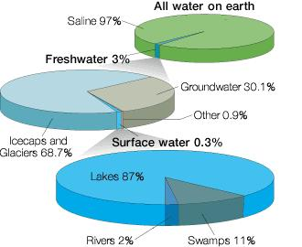
Why do we need to conserve water?

Slide 3
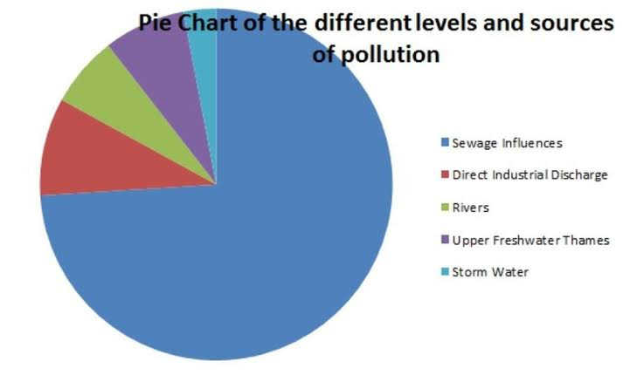

Slide 4
key activities to conserve water are :
Any beneficial reduction in water loss.
Avoiding use and waste of resources.
Avoiding any damage to water quality.
Improving water management practices .
Ex: Rain water harvesting , groundwater recharge etc. Avoiding water pollution.

Slide 5
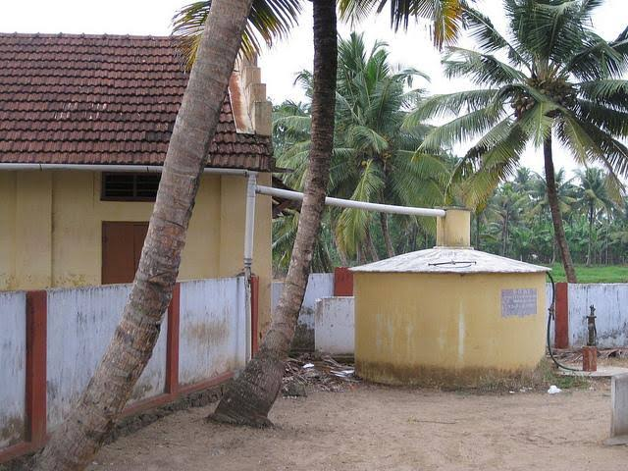
Rain water harvesting
Rainwater Harvesting is one of the most commonly used methods to save water. It refers to storing of rainwater for various uses.

Slide 6
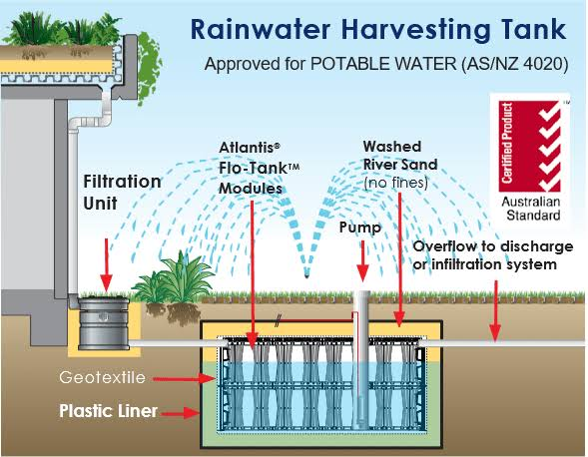
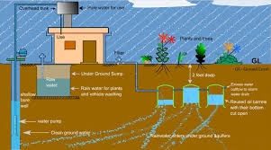
Blueprint of rain water harvesting

Slide 7
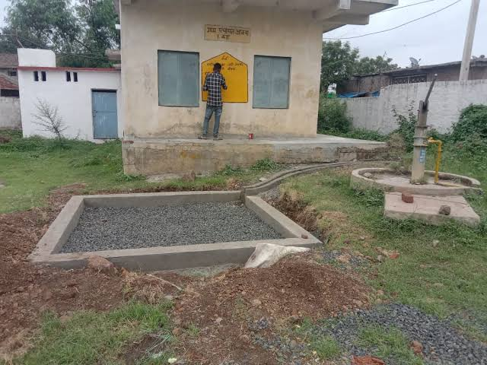
GroundWater Recharge
The process of Recollection of water in earth crust is known as ground water recharge

Slide 8
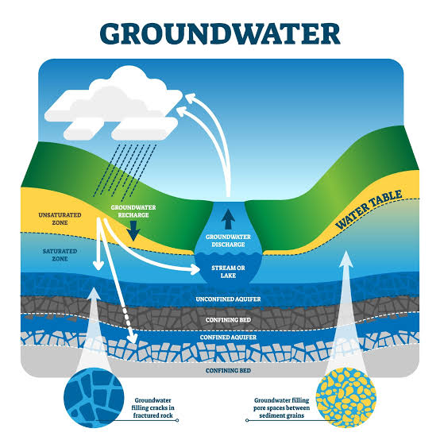
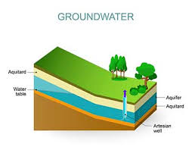

Slide 9
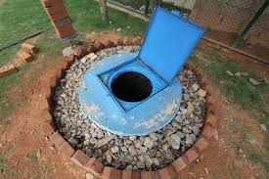
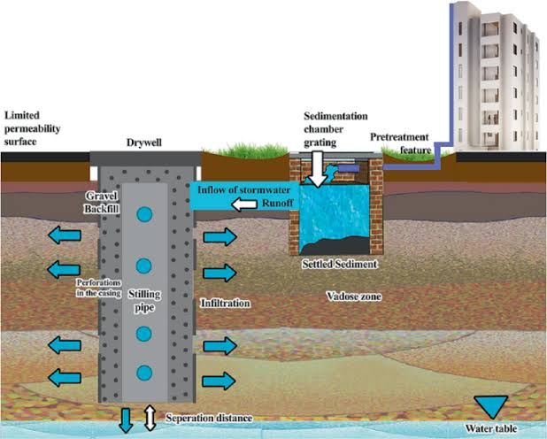
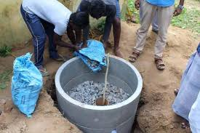
Methodology:

Slide 10
Thank you

